Slide 2

What is programming?
Programming is the process of creating a set of instructions that tell a computer how to perform a task.
It involves writing code in a programming language to solve specific problems or accomplish a specific task.​

Slide 3


Binary Representation of letters and numbers.
Lowercase Letters: a: 01100001 b: 01100010 c: 01100011 d: 01100100 e: 01100101 f: 01100110 g: 01100111 h: 01101000 i: 01101001 j: 01101010....
Numbers: 0: 00110000 1: 00110001 2: 00110010 3: 00110011...
Uppercase Letters:​ A: 01000001​ B: 01000010​ C: 01000011​ D: 01000100​ E: 01000101​.... ​ ​
​ ​ ​

Slide 4
Why learn programming?
Problem-Solving Skills: Programming helps you develop logical thinking and problem-solving skills. It involves breaking down complex problems into smaller, manageable parts, and solving them step by step.
Career Opportunities: There is a high demand for programmers in various industries such as technology, finance, healthcare, and more. Learning to program can open up a wide range of job opportunities.
Automation: If you find yourself doing repetitive tasks, programming can help automate those tasks, saving you time and effort.

Slide 5
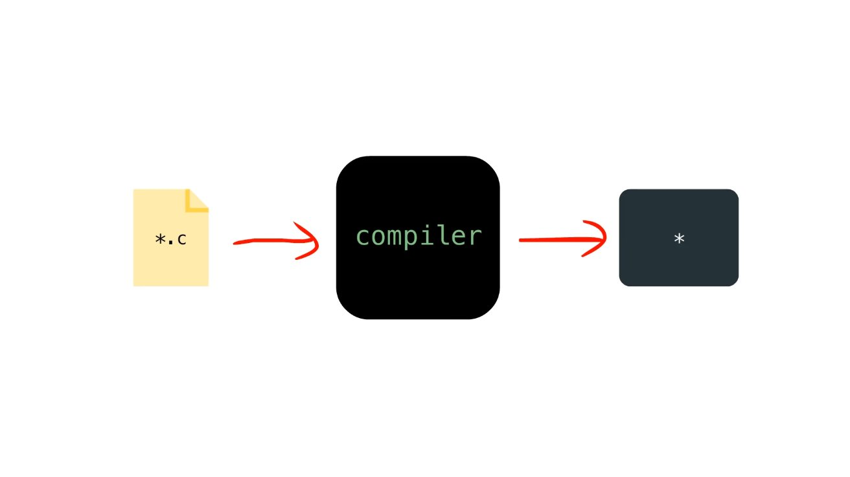
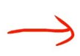
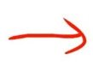
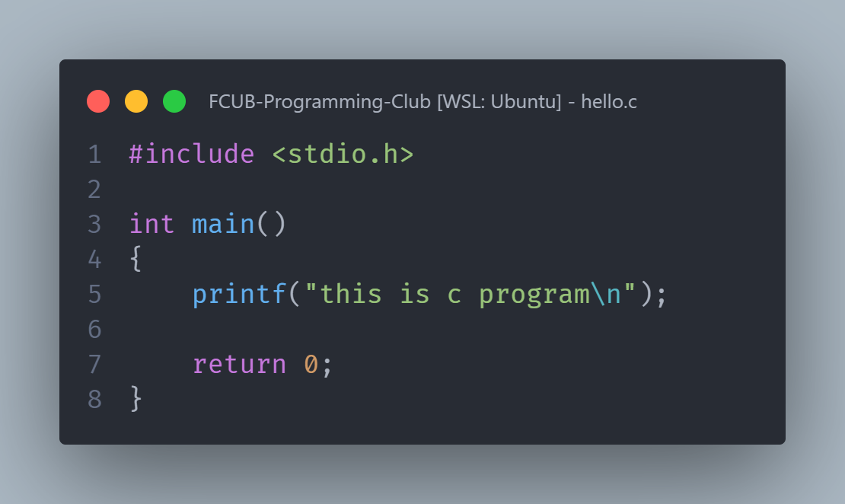
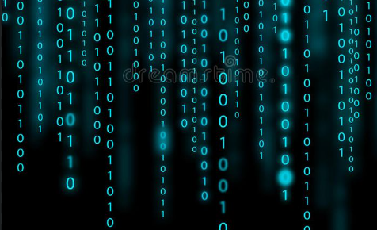

Slide 6
What is data type?

Slide 7
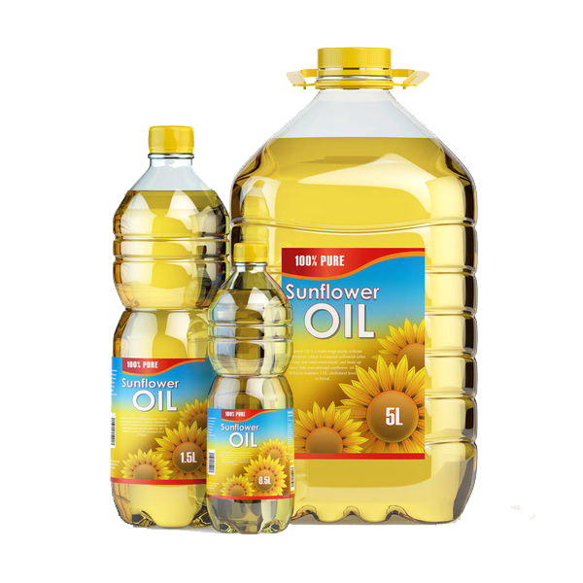

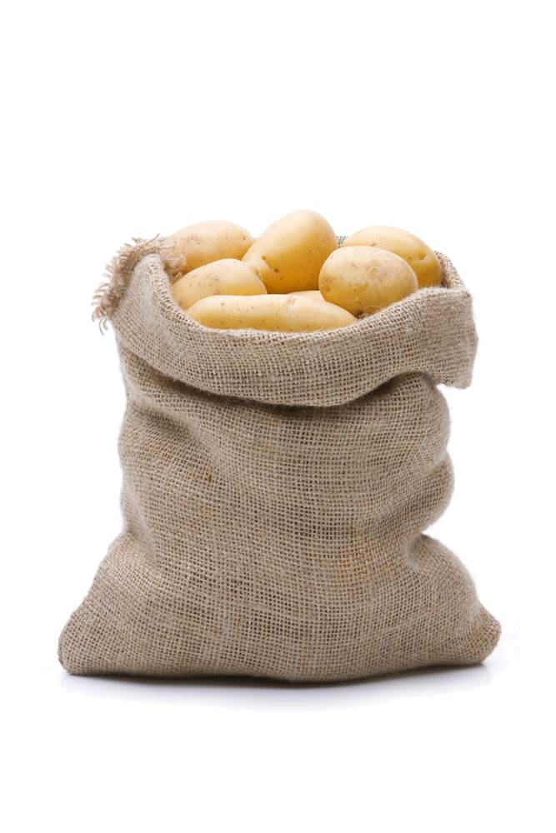
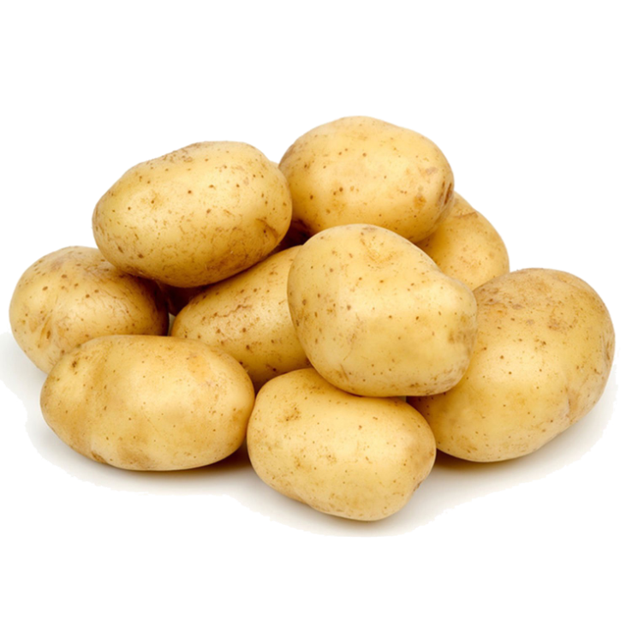
Data Type

Slide 8
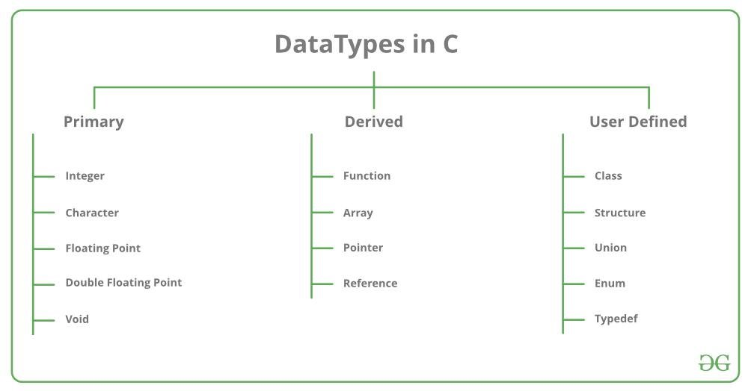

Slide 9

What is Variable?
Data types determine the operations that can be performed on the data, how the data is stored, and how much space it occupies in memory.

Slide 10

Variable naming rules:
A variable name can consist of letters (both uppercase and lowercase), digits, and the underscore character (_).
The first character of a variable name must be a letter or an underscore. Variable names are case-sensitive in C. For example, myVariable and myvariable are two different variables.
Reserved words (keywords) in C cannot be used as variable names. For example, int, char, float, etc.

Slide 11
Variables Example :
$dolar
!impossible
A_is_variable 5_taka kobir
X
X
✅
X
✅

Slide 12

Naming Conventions:
Camel Case:- numberOfStudents
Snake Case:- number_of_students
Pascal Case:- NumberOfStudents

Slide 13

Thank You

